Slide 1
Capstone Project - The Battle of Neighborhoods
Applied Data Science Capstone
IBM Data Science Professional Certificate
Harsh Kansara

Slide 2
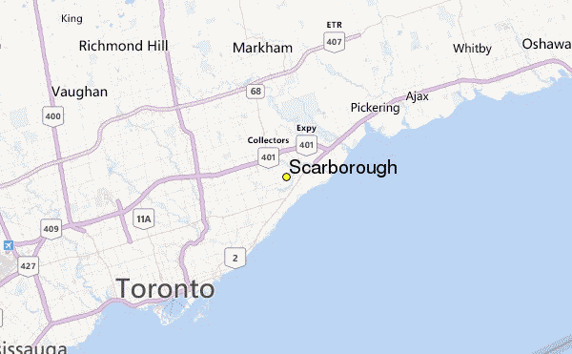

Slide 3
Business Problem
Students who want to pursue Masters in Countries like USA, CANADA, Australia , UK etc or the parents who want to migrate to countries like above from India considers search of good rating Universities / Schools and also the good Housing Prices. So to Address this problem we predict the solution of to create an analysis of features of neighborhood cities in a state of Canada between Neighborhoods. The features includes School ratings , median Housing price, weather conditions , crime rate etc. This will help students to figure out which country to choose , which universities to plan , what will the approx budget before going to that place where they are gonna start their new life.
The aim of the Project is to help students/ parents explore different possibilities and take better decision on choosing the best neighborhood out of many neighborhoods in Scarborough city based on the various features in and around that neighborhood.

Slide 4
Data
Longitude and Latitude Data:
We will need geo-locational information about that specific borough and the neighborhoods in that borough. It is "Scarborough" in Toronto.
Dataset comprising latitude and longitude, zipcodes is already available through the previous notebook. The location of Scarborough would be filtered using the same:

Slide 5
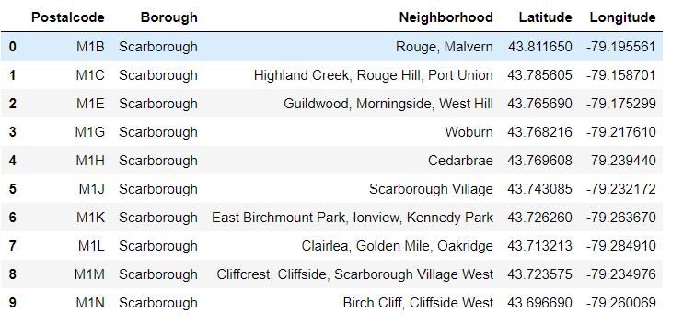

Slide 6
FourSquare API
Connecting to Foursquare and Retrieving Locational Data for Each Venue in Every Neighborhood
After finding the list of neighborhoods, we then connect to the Foursquare API to gather information about venues inside each and every neighborhood. For each neighborhood, we have chosen the radius to be 100 meter.

Slide 7
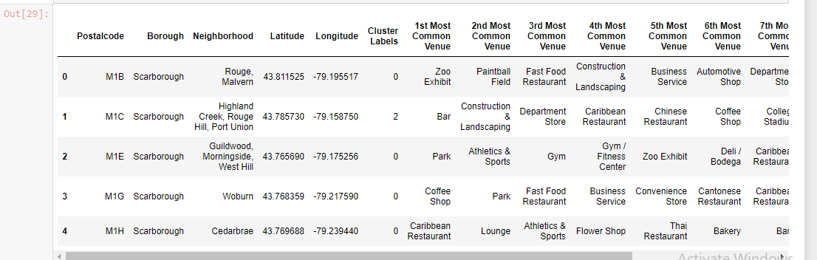
Finding Most Common Venues

Slide 8
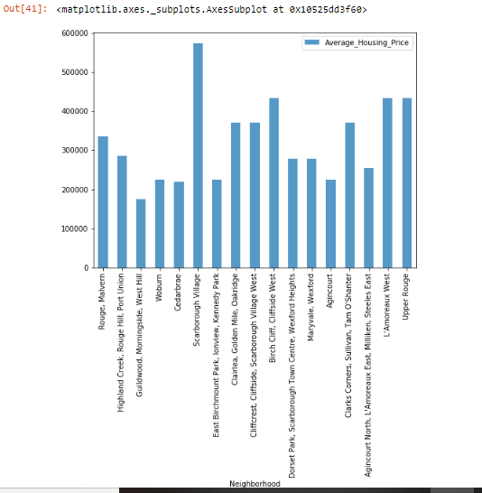
NEIGHBORHOOD MEDIAN HOUSING PRICES

Slide 9
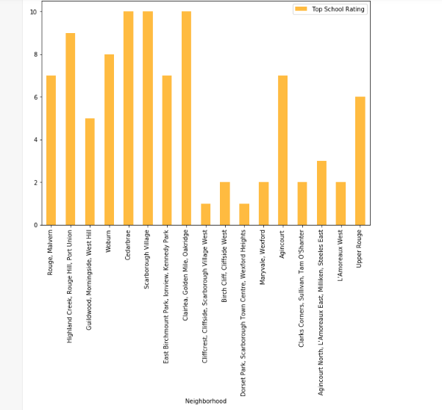
NEIGHBORHOOD SCHOOL RATINGS

Slide 10
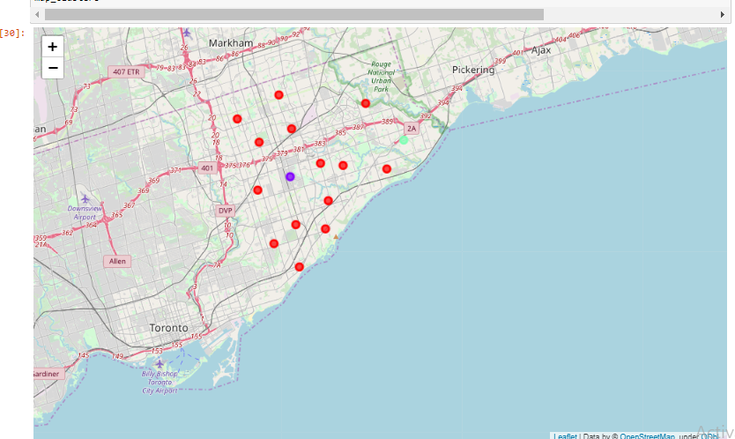
Conclusion
In this project, through a k-means cluster algorithm we separate the neighborhood into 03 clusters, which have similar neighborhoods around them. Using the charts above decision leading to a particular neighborhood based on average house prices and school rating can be made

